Slide 1
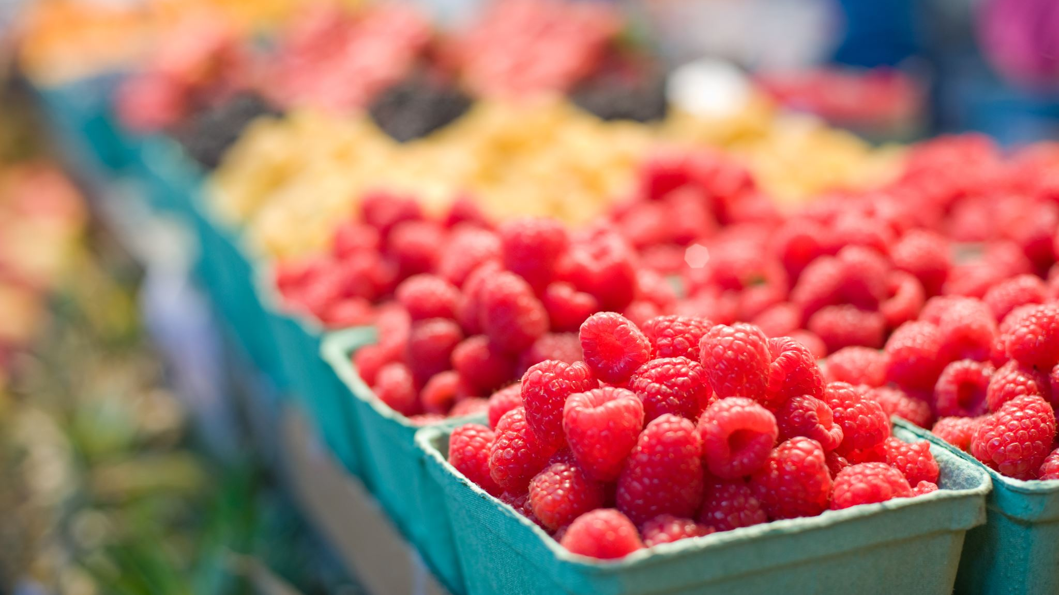
Hack For Sustainability Food Waste Reminder

Slide 2

SAVE FOOD !!!! ERADICATE HUNGER!!!
Goal 2 – Zero Hunger – pledges to end hunger

Slide 3
Abstract
This Hack aims to remind the user to use the grocerys based on the degree of perishability which is predicted based on temperature and moisture .
We are building a website which shows the flow of execution of our idea with a user friendly GUI

Slide 4
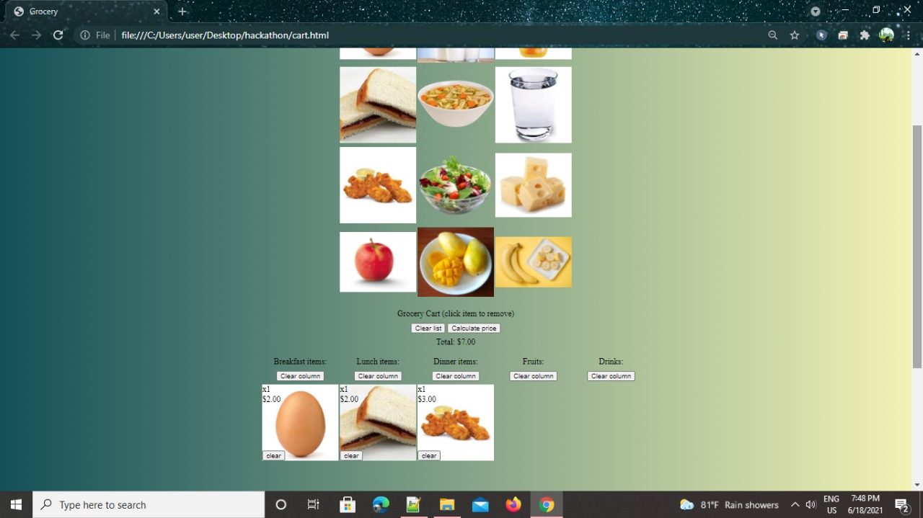
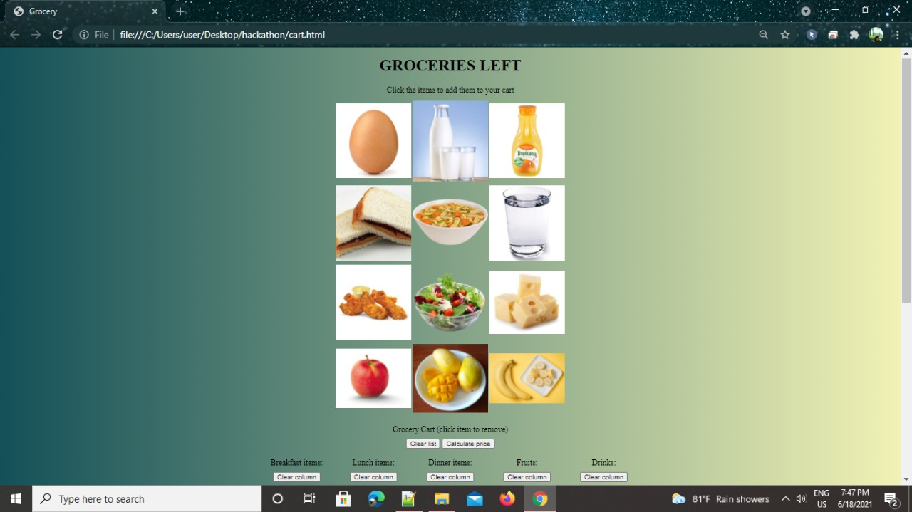
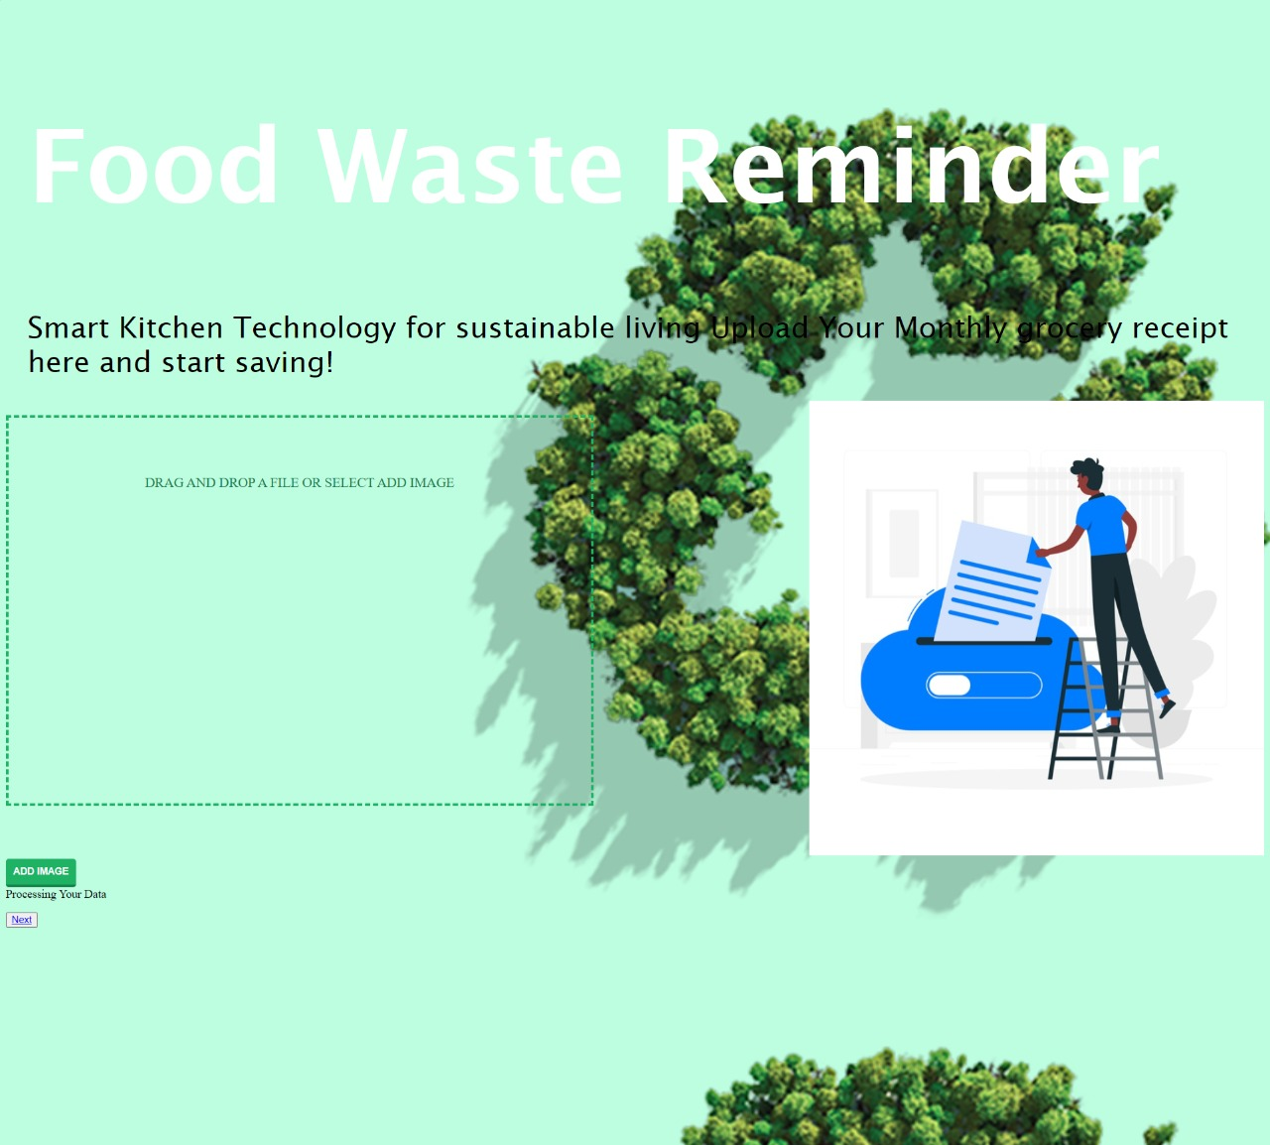
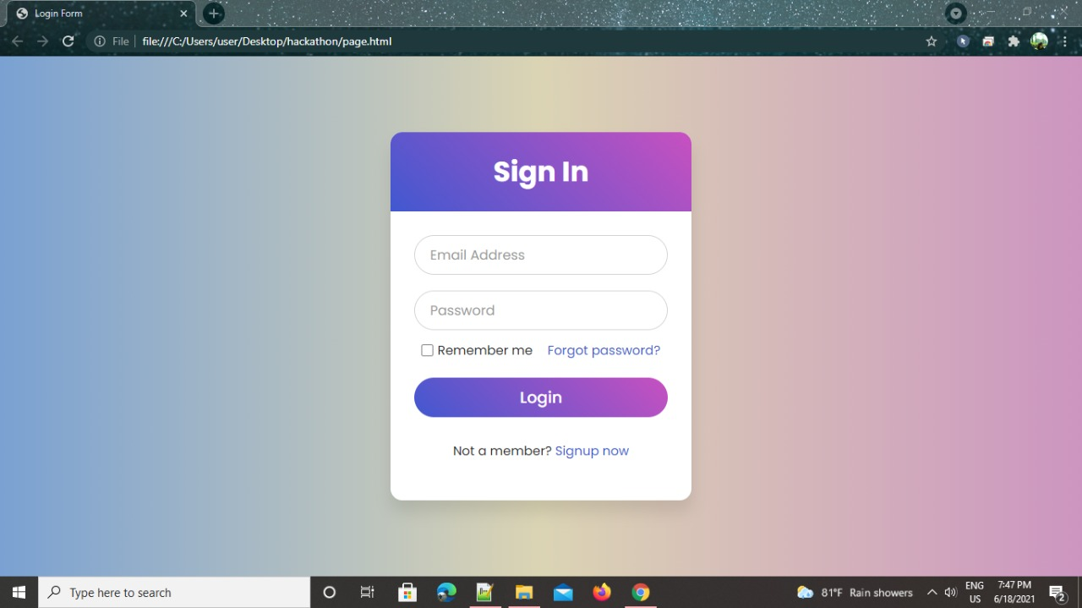
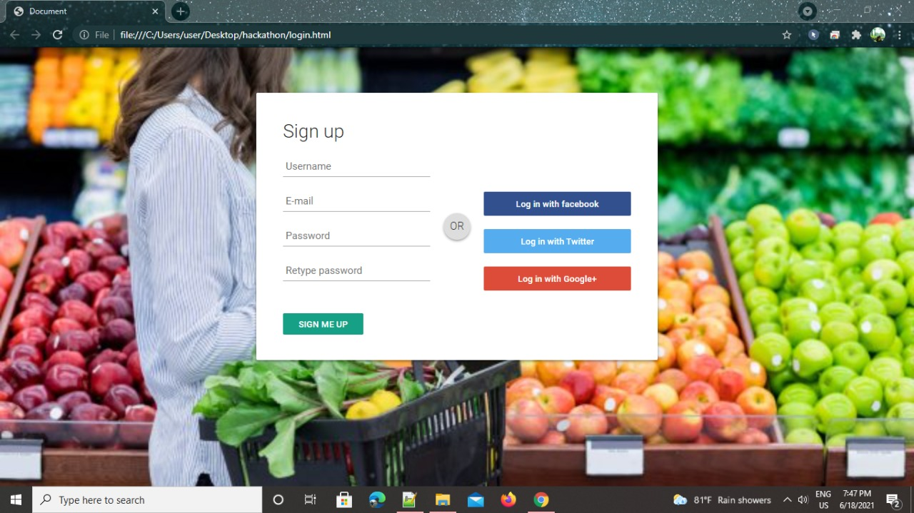

Slide 5
Backend
We have used a classification algorithm-Decision Tree which is a supervised learning technique.
Decision Trees usually mimic human thinking ability while making a decision, so it is easy to understand and works accurately for small datasets.
The logic behind the decision tree can be easily understood because it shows a tree-like structure.

Slide 6
Working of the model
We have used a dataset named Items.csv which consists of temperature, moisture and the degree of perishability based on temperture and moisture .
The prediction shows –1 for not perishable, 0 for may or may not perish and 1 for highly perishable.
The link to the working
Working

Slide 7
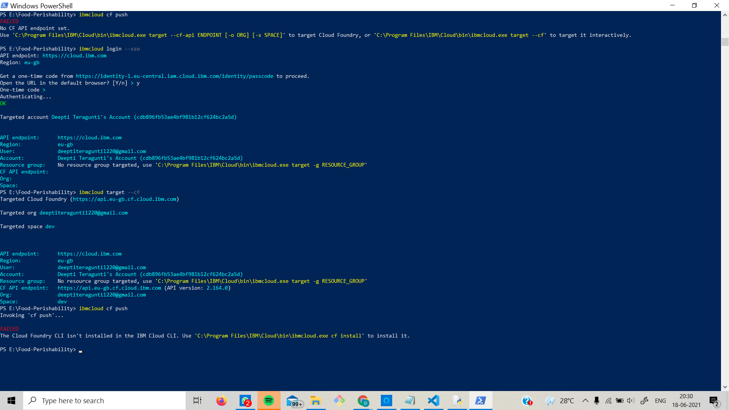
We are going to deploy it on IBM's Cloud Foundary

Slide 8

THANK YOU!!!!

